Slide 1
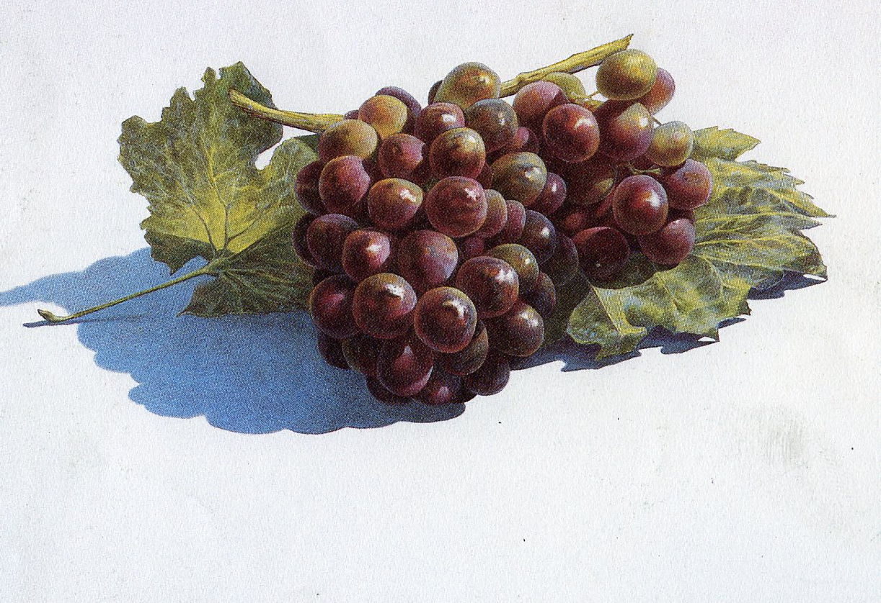
Color Pencil Techniques

Slide 2
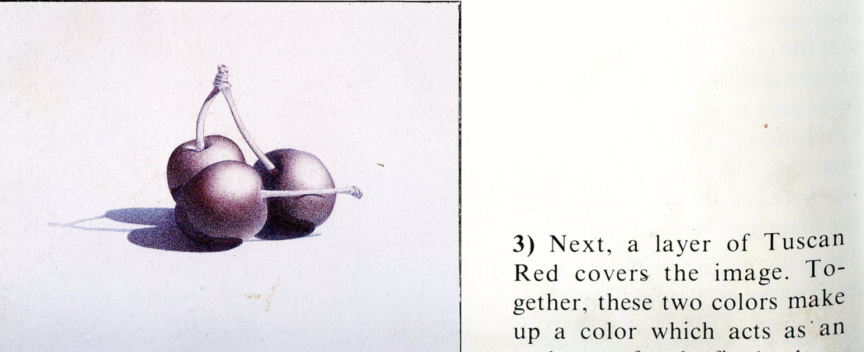
Indigo Blue & Tuscan Red

Slide 3
Crimson and Scarlet Red

Slide 4
